Slide 1



Python: Web Automation & Web scrapping
Presenter
Mohammad Anees Alam
Notes:
1

Slide 2
Today's agenda!
1
Fundamentals of Web Automation
2
Understanding HTTP requests
3
Web scraping and extraction
4
How data processing works
5
Exploring pandas & numpy libraries
6
Automate web scraping (hands-on)
Notes:
2

Slide 3
What is Web Automation?
  It automates the interaction with web applications and enables performing repetitive tasks.
  In a DevOps environment, the primary goal is to bridge the gap between development and operations teams.
  Popular tools for Web Automation in DevOps are Selenium, Puppeteer, Playwright.
  Some common use cases for web automation are listed below:
Automated Testing
Continuous Integration/Continuous Deployment (CI/CD)
Infrastructure Automation
Monitoring & Reporting
Ensures code quality by automating tests.
Managing web servers and applications automatically.
Automating the monitoring of web applications to detect issues early in the software lifecycle.
Automating the build, testing, and deployment processes
Notes:
3

Slide 4
Benefits & Challenges of Web Automation in DevOps
When it comes to web automation, there are possible challenges along with the benefits on the upside.
Benefits
Challenges
Increased Speed
Tooling Complexity
Consistency and Reliability
Test Maintenance
Scalability
Performance Considerations
Better Collaboration
Security Risks
Best Practices:
  Modularize Automation Scripts: Keep your automation scripts modular and reusable to save time.
  Integrate with CI/CD Tools: Use web automation tools with CI/CD pipeline to get immediate feedback on code quality.
  Use Version Control: Automate scripts and tests should be kept under version control to ensure changes are tracked.
  Monitor Automation Performance: Regularly monitor the performance of your automation tests and scripts.
Notes:
4

Slide 5
HTTP Requests and Responses
  HTTP stands for Hypertext Transfer Protocol.
  It's the protocol used to request and transmit resources over the internet, such as HTML pages, images, videos etc.
  HTTP operates on a request-response model, an HTTP request is sent by a client (typically a web browser or an API client) to request a resource from a web server.
  An HTTP response is sent by a server in reply to an HTTP request. It contains the status of the request and any data that the server is returning
Structure of HTTP Request
Structure of HTTP Response
Request Line:
Status Line:
HTTP methods like GET, POST, PUT, DELETE.
  HTTP Version: Version of HTTP used by the server.
Request URL that identifies the resource being requested.
  Status Code: 3-digit code indicating the result of request.
HTTP Version: Specifies the version of HTTP being used.
  Status Message: A brief description of the status code.
  Ex: HTTP/1.1 200 OK
Headers:
Headers:
Headers provide additional information about the request, such as the type of content being sent.
Like HTTP requests, HTTP responses also include headers that provide additional information about the response.
  User-Agent: Specifies the client software making the request (e.g., a browser or a mobile app).
  Content-Length: The size of the response body.
  Location: Used in redirections (e.g., 301 status code).
  Content-Type: Specifies the type of data being sent in the request body
Response Body:
Request Body:
The body of the response contains the data returned by the server, like:
Contains data as Some HTTP methods, like POST or PUT, may contain a body that sends data to the server.
  HTML content for web pages.
  Images or videos, plain text, PDF files, etc.
Notes:
5

Slide 6
Commonly used Status codes & Request Headers.
Status Codes
Description
2xx (Successful)
The request was successfully processed.
3xx (Redirection)
The client must take additional action to complete the request.
4xx (Client Error)
The request contains an error or is invalid.
5xx (Server Error)
The server encountered an error while processing the request.
Request Headers
Description
User-Agent
Specifies the client software making the request (e.g., a browser / app).
Accept
Specifies the media types the client is willing to accept (e.g., text/html, application/json).
Content-Type
Specifies the type of data being sent in the request body (e.g., application/json, application/x-www-form-urlencoded).
Authorization
Contains credentials for authenticating with the server (e.g., a bearer token or basic auth).
Location
Used in redirections (e.g., when a 301 status code is returned, this header indicates the new URL).
Notes:
6

Slide 7
HTTP Methods and Their Purposes
HTTP defines several methods that indicate the desired action on a resource.
Each method serves a specific purpose in the context of request-response interactions:
  GET: Requests a representation of the specified resource. It should only retrieve data and have no side effects.
  POST: Sends data to the server to create a new resource or trigger a server-side operation (e.g., form submissions).
  PUT: Replaces the current state of the resource with the new data.
  DELETE: Deletes the specified resource.
  PATCH: Partially updates a resource.
  HEAD: Similar to GET but only requests the headers, not the body of the response.
  OPTIONS: Retrieves the allowed HTTP methods and other capabilities supported by the server.
Notes:
7

Slide 8
Requests Library
The Requests Library is a popular Python library used to send HTTP requests and handle responses in a simple and efficient way.
response.text
response.status_code
import requests
# Sending a GET request to a URL
response = requests.get('https://example.com')
# Checking the status code of the response
if response.status_code == 200:
print("Request successful!")
# Print the content of the webpage (HTML)
print(response.text)
Contains the server’s response as a string (e.g., HTML or text).
Returns the HTTP status code (e.g., 200 for success, 404 for not found).
response.content
response.json()
Contains the raw bytes of the response, useful for binary data like images or files.
Converts a JSON response into a Python dictionary (only works if the response is in JSON format).
Notes:
8

Slide 9

Hands-on Activity!
Task:
Write a script to fetch and display the HTML content of your desired webpage.
Steps:
  Choose any website (e.g., https://bbc.com).
  Use the requests library to send a GET request to fetch the HTML content.
  Print the HTML content of the page.
Notes:
9

Slide 10

Web Scraping with BeautifulSoup
  Web scraping refers to extracting data from web pages by parsing the HTML.
  It can be used to gather information like product listings, news articles, or any publicly available data.
BeautifulSoup4 Library (bs4)
BeautifulSoup is a Python library for parsing HTML or XML documents and extracting data. It provides tools to navigate, search, and modify the parse tree of a webpage, making data extraction easier.
Notes:
10

Slide 11
How is it different from Web automation??
1
Goal:
2
Tools:
  Scraping: Extracting data from the web.
  Scraping: BeautifulSoup, Scrapy, Requests.
  Automation: Selenium, Playwright, Puppeteer.
  Automation: Performing actions (e.g., clicking, filling out forms) on a website.
3
Use Cases:
4
Interaction Level:
  Scraping: Usually interacts with the HTML content without rendering the page (does not simulate user actions).
  Scraping: Collecting data for analysis, building datasets, or monitoring changes.
  Automation: Testing websites, automating manual tasks, interacting with dynamic content (e.g., JavaScript-rendered pages).
  Automation: Interacts with the website as if it's a real user (can simulate clicks, form submissions, etc.).
Notes:
11

Slide 12

Ethical Considerations for Scraping
Ethical web scraping is crucial to avoid disrupting websites and ensure responsible data collection.
Respecting robots.txt and implementing rate limiting are essential practices for maintaining good relations with website owners.
Robots.txt
Always check the website’s robots.txt file to ensure that scraping is permitted. This file specifies which parts of the site should not be accessed by web crawlers.
Rate Limiting
Avoid sending too many requests in a short period to prevent overloading the server. Implement delays between requests to mimic human behavior and avoid being blocked.
To check robots.txt:
You can open a web browser and visit the robots.txt file directly by typing: https://example.com/robots.txt
Notes:
12

Slide 13
Hands-on Activity!
Task:
Scrape the HTML content of your desired webpage.
Steps:
  Choose any website (e.g., https://bbc.com).
  Use the beautifulSoup4 & requests libraries to scrape the HTML content.
  Print the HTML content of the page.
ASSIGNMENT
Task: Write a script to scrape article titles and links from a news website.
  Choose a news site.
  Use requests library to fetch the page content.
  Use BeautifulSoup to extract all article titles and their corresponding links.
Notes:
13

Slide 14


Data Processing with Pandas & NumPy libraries
Pandas and NumPy are two powerful libraries in Python that are frequently used in data manipulation, analysis, and scientific computing.
NumPy
Pandas
NumPy is best used for numerical computations, such as performing array operations, working with large datasets, or performing linear algebra.
Pandas is a high-level data manipulation tool built on top of NumPy, primarily used for structured data.
  It provides data structures like DataFrame that make it easy to work with tables of data (similar to SQL tables or Excel spreadsheets).
Notes:
14

Slide 15
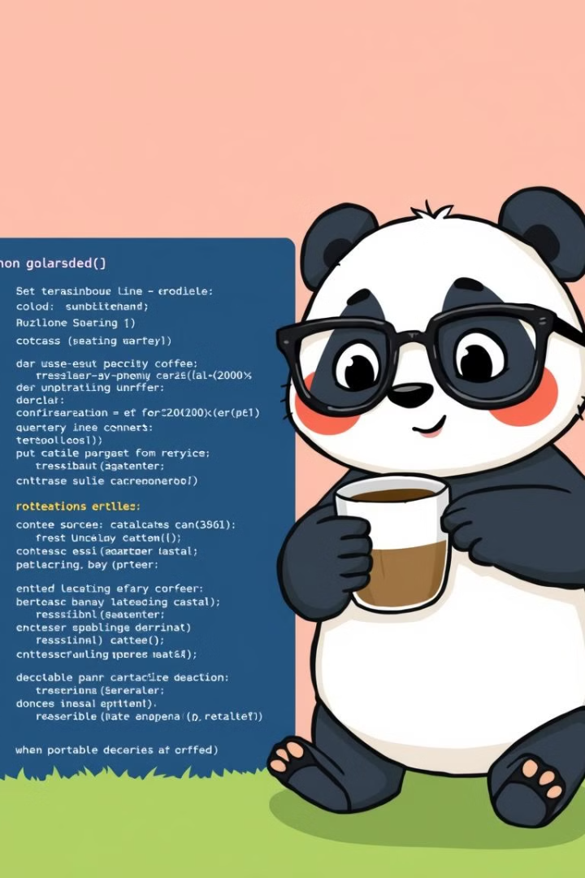


Pandas vs. NumPy
Pandas
Use Pandas when you need to work with structured data, handle missing data, perform data manipulation, and read/write data to/from various file formats like CSV and Excel.
Example: Extract and filter logs to identify errors or performance issues over time.
NumPy
Use NumPy when you need to perform efficient numerical computations on large arrays, conduct vectorized operations, and require fast performance for linear algebra and statistical analysis.
Example: Use NumPy to calculate statistics like average, min, and max CPU usage for trend analysis.
Pandas and NumPy are both powerful libraries for data manipulation and analysis, but they serve different purposes.
Pandas is great for data processing, while NumPy excels at numerical calculations on arrays.
Notes:
15

Slide 16
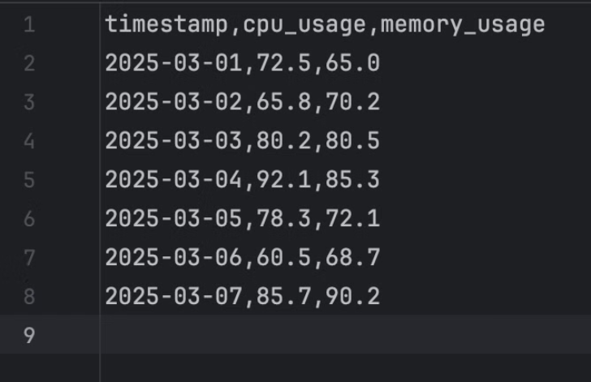
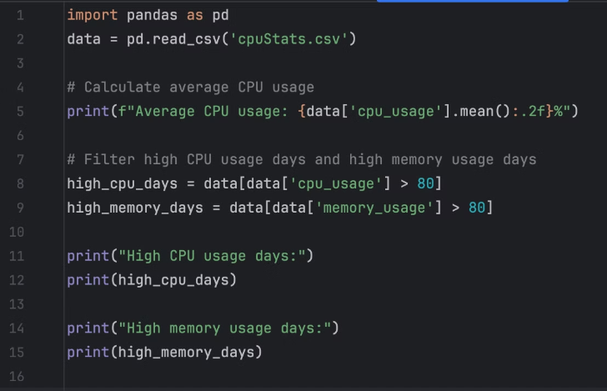
Hands-on Activity!
Let's analyze how Pandas library is used with a real-world DevOps task.
  The left image is a CSV file with random data, the right image demonstrates how a CSV file is processed in pandas.
  Task: Load a dataset using Pandas, clean it, and perform basic analysis.
Notes:
16

Slide 17
Introduction to Automation Tasks
Automation in DevOps means using scripts and tools to reduce manual work, increase speed, and avoid human errors.
Anything that is repetitive, time-consuming, or data-driven should be automated.
Why Automation?
Manual Work | Automated Solution
Takes time | Runs in seconds
Prone to mistakes | Consistent results
Needs humans always | Can run 24×7
Hard to scale | Scales easily for large workloads
Real-World Automation Scenarios:
  Web Scraping: Automatically collecting data from websites for analysis.
  Data Extraction: Extracting specific data from reports, logs, or web pages.
  Repetitive Tasks: Automating tasks such as form submissions, uploading files, etc.
Notes:
7

Slide 18
Automating Data Scraping to CSV
  Define the file path where the CSV will be saved.
  Send an HTTP GET request to https://cnn.com and gets the HTML content.
  Write a logic that opens a CSV file and writes the header (Title and Link).
  Get the data printed in a specified path.
Fetch Data
Save to CSV
1
2
3
Extract Data
Notes:
17

Slide 19

Key Takeaways
  Web automation refers to using tools and scripts to automatically perform tasks on a website, such as form submissions, clicking buttons, or navigating pages, often using tools like Selenium or Puppeteer.
  HTTP request is a message sent by a client to a server to request data or perform an action, specifying the method, headers, and optional body.
  HTTP response is the server's reply, containing a status code (e.g., 200 for success), headers, and the requested data or result in the body.
  Web scraping involves extracting data from websites by parsing HTML content, typically using tools like BeautifulSoup or Scrapy, to collect information such as text, links, or images for analysis or storage.
  Pandas is a Python library used for data manipulation and analysis, providing powerful tools like DataFrames for handling structured data.
  NumPy is a library for numerical computing in Python, offering support for large, multi-dimensional arrays and matrices, along with mathematical functions to operate on them
Notes:
18

